Slide 1


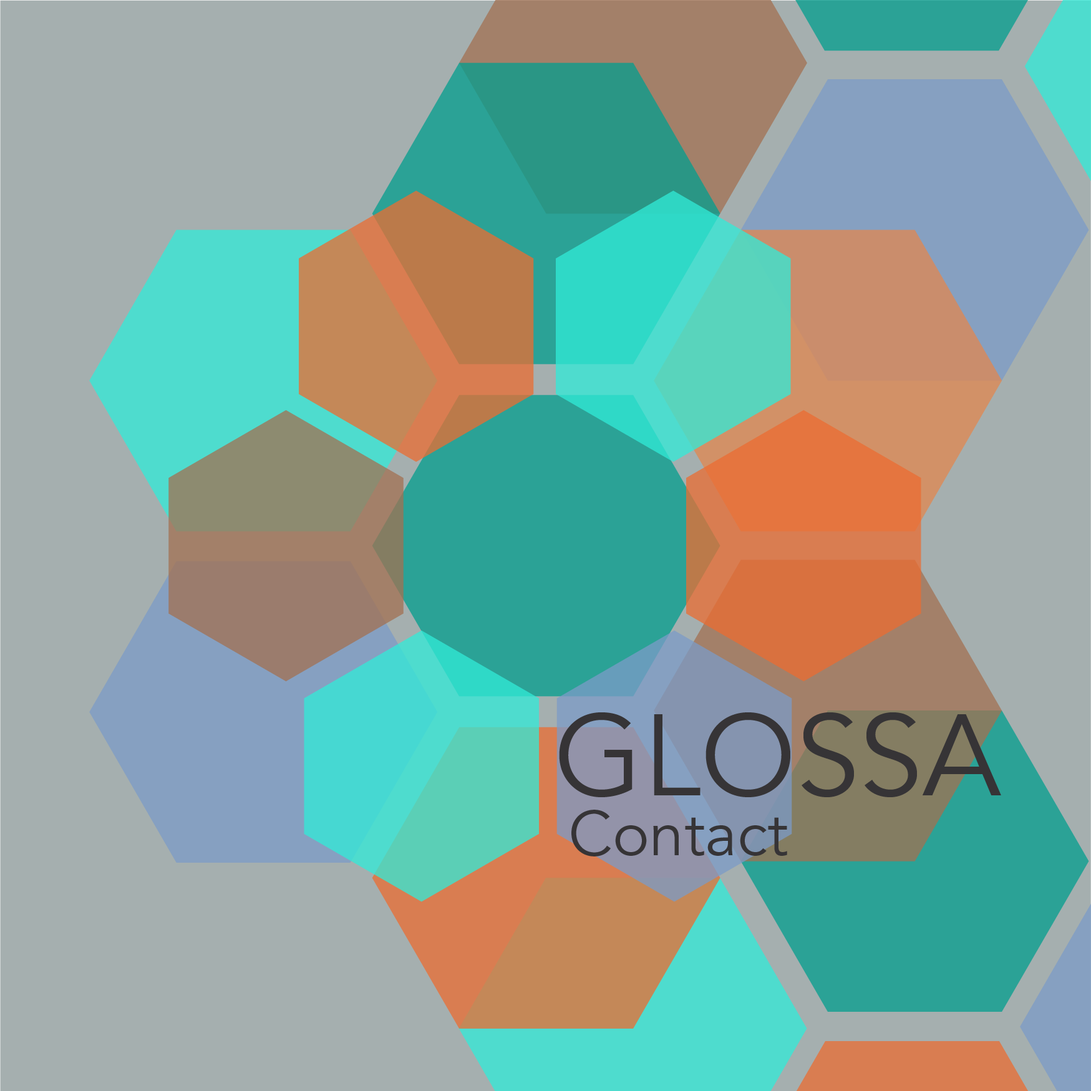
Delphi Workshop 2025 Opening
Organizing Committee • Corporа and Diachrony

Slide 2
Welcome to Delphi
European Cultural Centre of Delphi as our hub
Gathering linguists, philologists, and digital humanists
Four immersive days: 26–29 November 2025

Slide 3
Why Delphi?
Ancient center of wisdom inspiring corpus-based prophecy
Proximity to archaeological treasures energizes dialogue
Connects past messages to future research tools

Slide 4
Our Mission
Advance corpus-based approaches to text types and change
Blend computational methods with philological expertise
Deliver valency lexica for ancient and medieval languages

Slide 5
Meet the Organizing Committee
Nikolaos Lavidas • Kiki Nikiforidou • Vassiliki Geka
Vassilios Symeonidis • Sofia Chionidi • Anastasia Tsiropina
Eleni Plakoutsi • Theodoros Michalareas

Slide 6
Program Snapshot
Arrival, Opening, Deep Dive, Technology & Futures
Keynotes, invited talks, project presentations
Breakouts, cultural visits, and collaborative labs

Slide 7
Guiding Themes
Influential texts across genres and centuries
Diachronic corpora + argument structure annotation
Interplay between text types, grammar, and change

Slide 8
Keynote Line-up
Dag Haug • George Mikros • Carola Trips
Alexandros Tantos • Ioanna Sitaridou
Each anchors a methodological perspective

Slide 9
Invited Speakers
Span Europe and multiple traditions
Showcase valency, construction grammar, and corpora
Connect to AthDGC priorities

Slide 10
Project Presentation
AthDGC team reveals translation-based change pipeline
Demonstrates PROIEL alignment and diachronic tracking
Sets foundation for collaborative tasks

Slide 11
ARCAS & Harvard Collaboration
Computational classics meets AthDGC corpora
Shared infrastructure for annotation and tooling
Joint sessions highlight synergies

Slide 12
Athens–Naxos–Delphi Continuum
Builds on previous schools and workshops
Maps future activity nodes
Reinforces Greek-led leadership in diachrony

Slide 13
Expected Outcomes
Shared corpora + methodological playbooks
Position papers and publication plans
Mentored pathways for early-career scholars

Slide 14
Methodological Mix
Annotation frameworks + NLP pipelines
Philological close reading
Experiments on genre-sensitive change

Slide 15
Digital Infrastructure
PROIEL-compatible layers
Stanza integration and visualization dashboards
Open data commitments

Slide 16
Engagement Principles
Respectful debate • cross-disciplinary curiosity
Use shared pad for questions and resources
Signal-boost junior researchers

Slide 17
Cultural Program
Site tours and museum visits
Evening salons with local experts
Opportunities for informal collaborations

Slide 18
Logistics & Support
Guesthouse details • Wi-Fi • emergency contacts
Recording and photo policy
Sustainability guidelines

Slide 19
Participation Call
Every talk closes with a question slide
Submit topics for Saturday lab
Bring your datasets for lightning demos

Slide 20
Opening Questions
Which text type challenges you most?
What tool or corpus do you want to share?
How will you measure your Delphi success?

